Slide 1
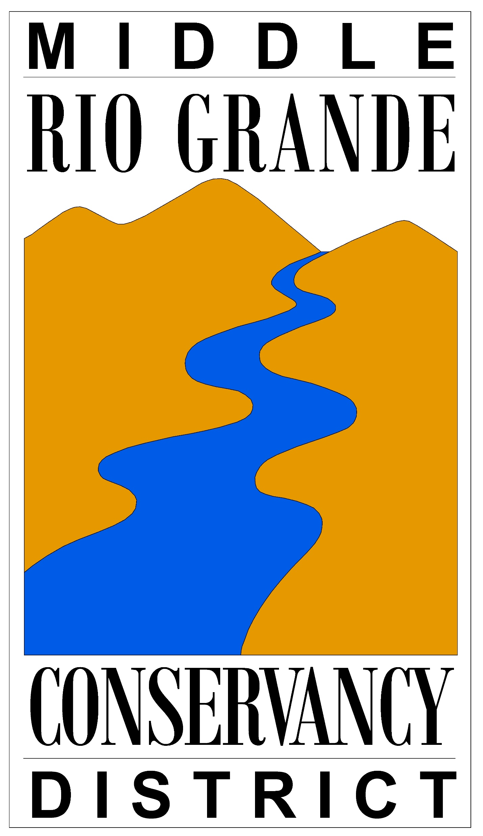
MIDDLE RIO GRANDE CONSERVANCY DISTRICT
5-Year Budget Forecast
Review & Recommendation
March 13, 2023
Notes:
I am here to present the Districts 5-year forecast, present the issues related to the 5 year forecast, and to make some recommendations.
I do not come here to present a problem without a solution

Slide 2
PROBLEM
  The District is bringing in enough funding to cover operating costs but not enough to cover debt service and capital expenditures.

Slide 3
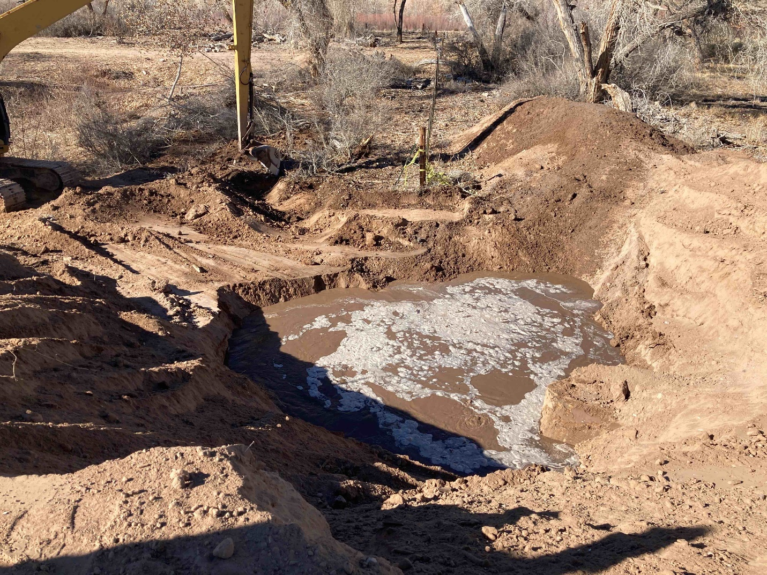
Corrales Siphon Sink Hole, East Side, 2022
Capital infrastructure is failing causing the District to spend resources on temporary and permanent solutions.
FY2022 Actual Expenditures $ 425,000
FY2023 Actual Expenditures YTD $ 910,000
FY 2023 encumbrances outstanding $375,000
Total $1,710,000

Slide 4
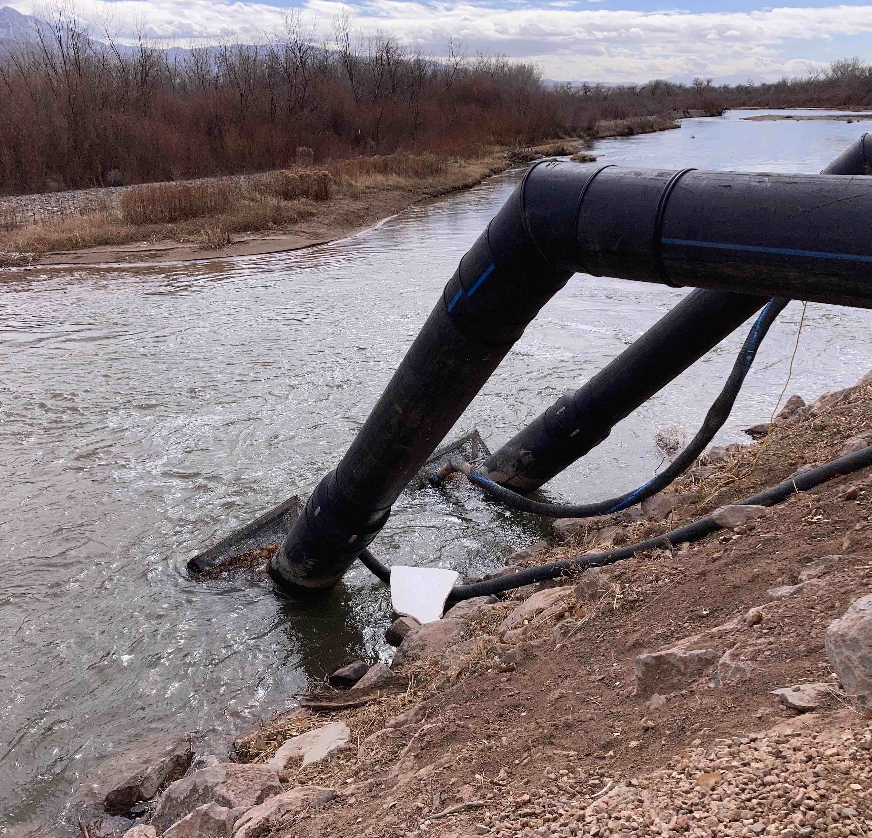
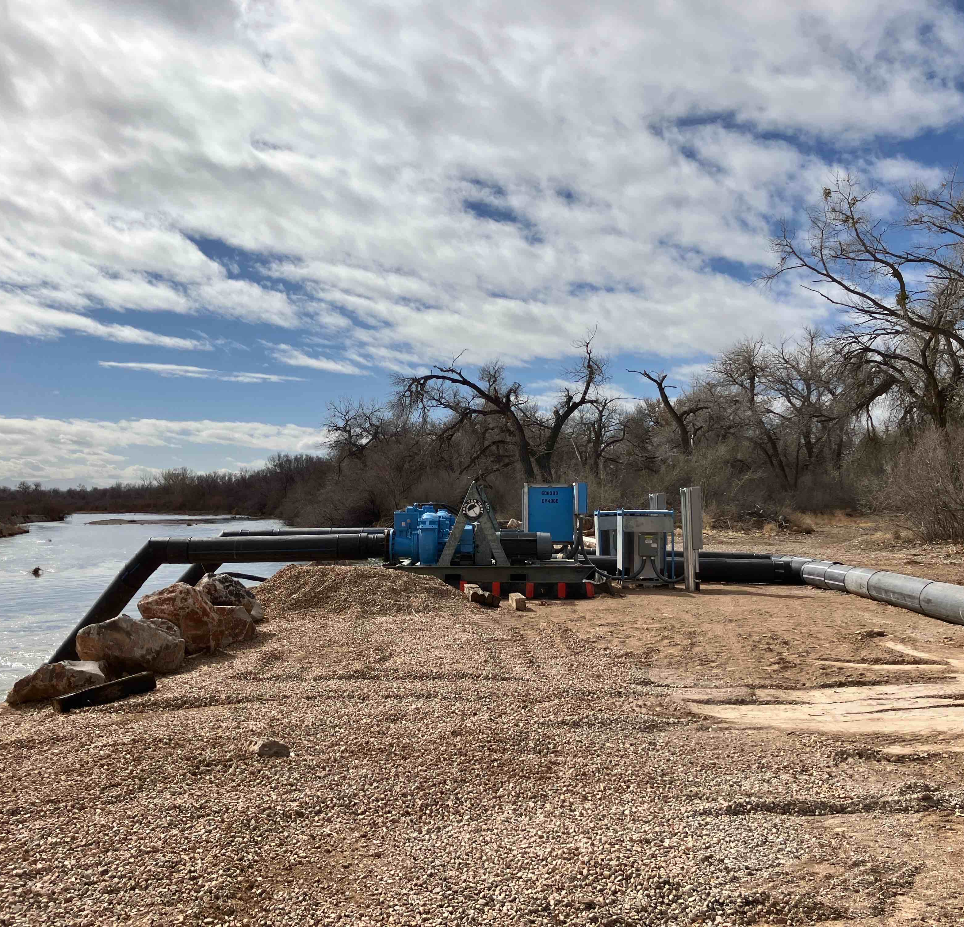
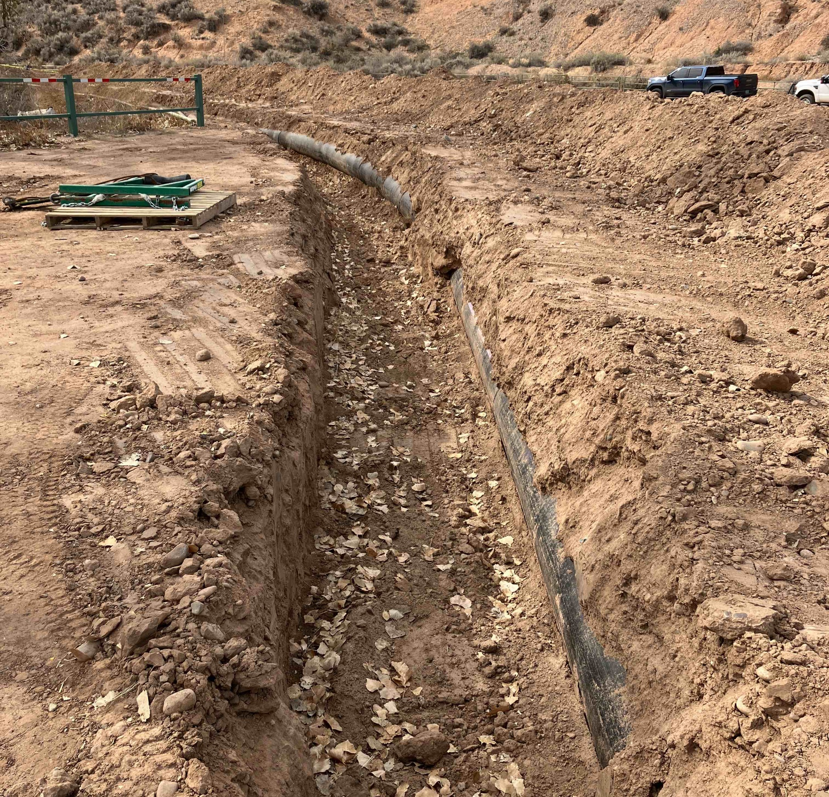
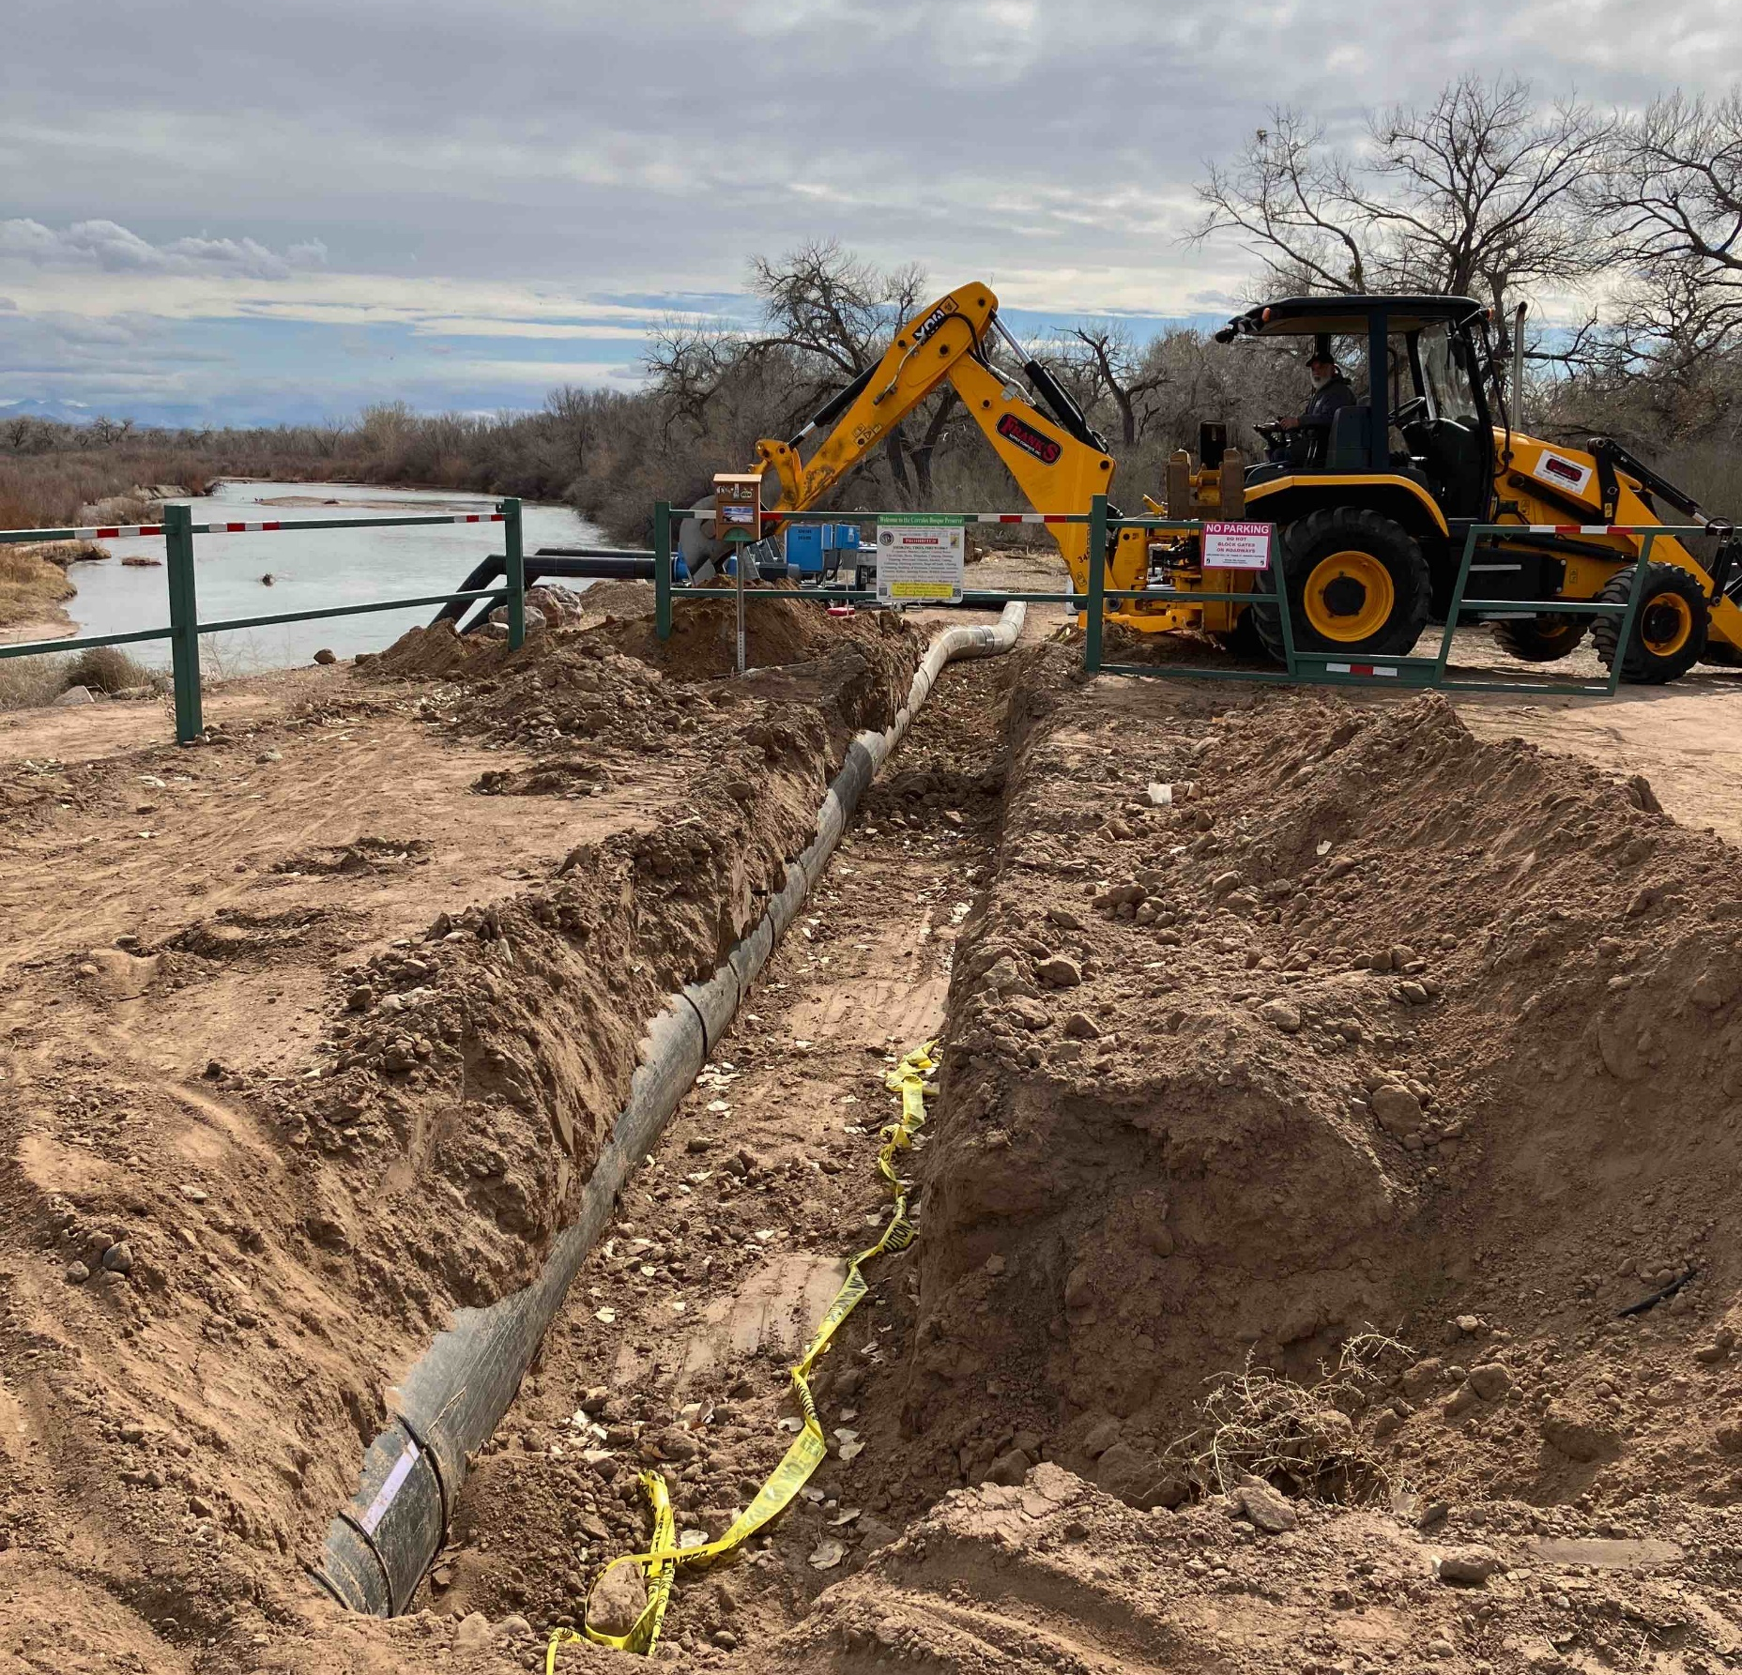
Corrales Siphon Pumping Operations

Slide 5
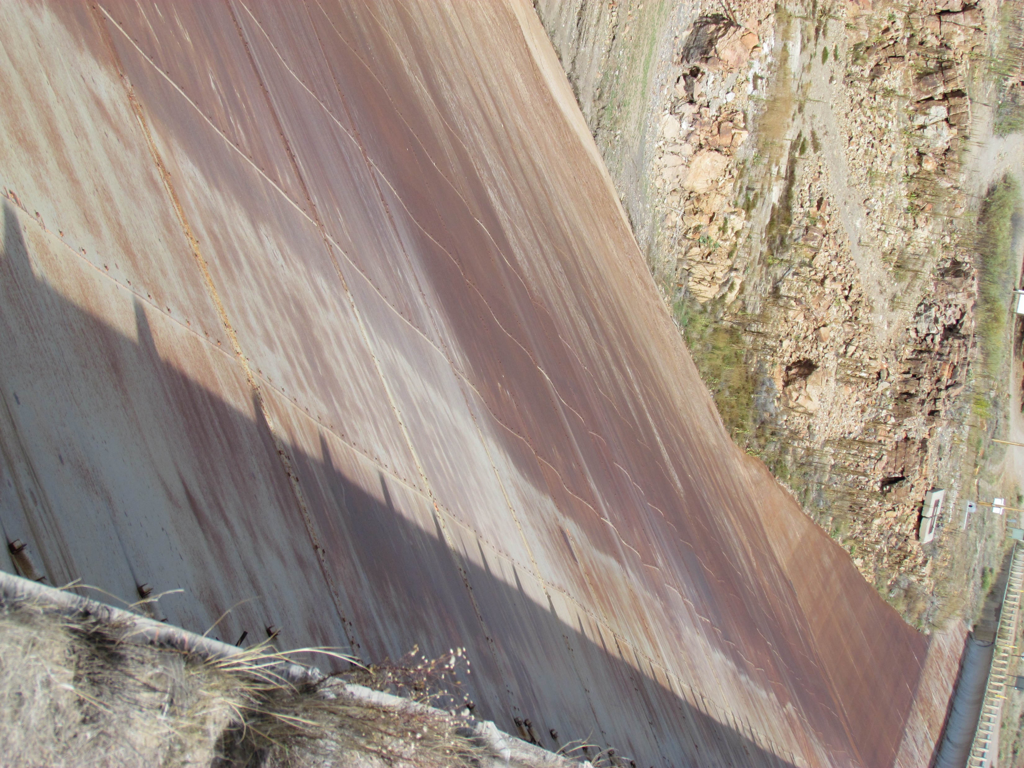
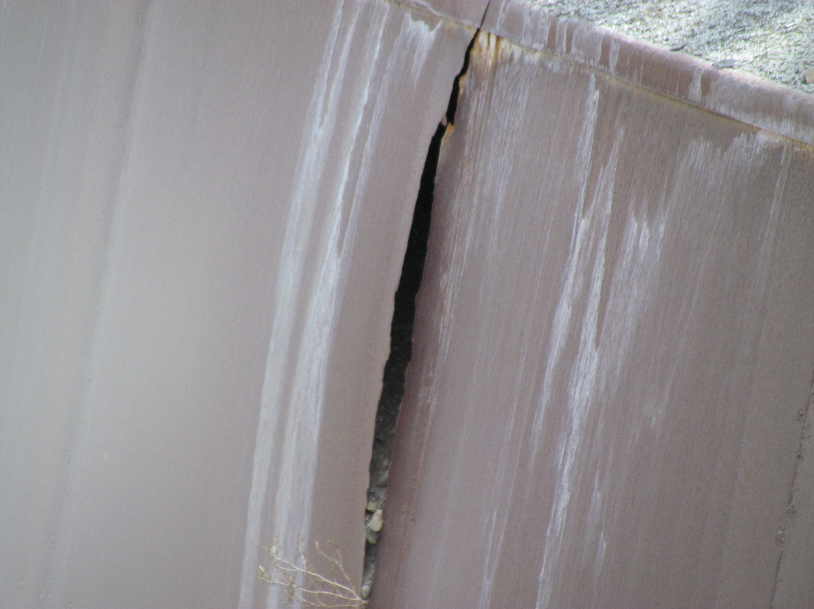
El Vado Dam
  When costly infrastructure fails, the District needs to have the funds or the ability to secure the funds to repair or replace it.
5

Slide 6
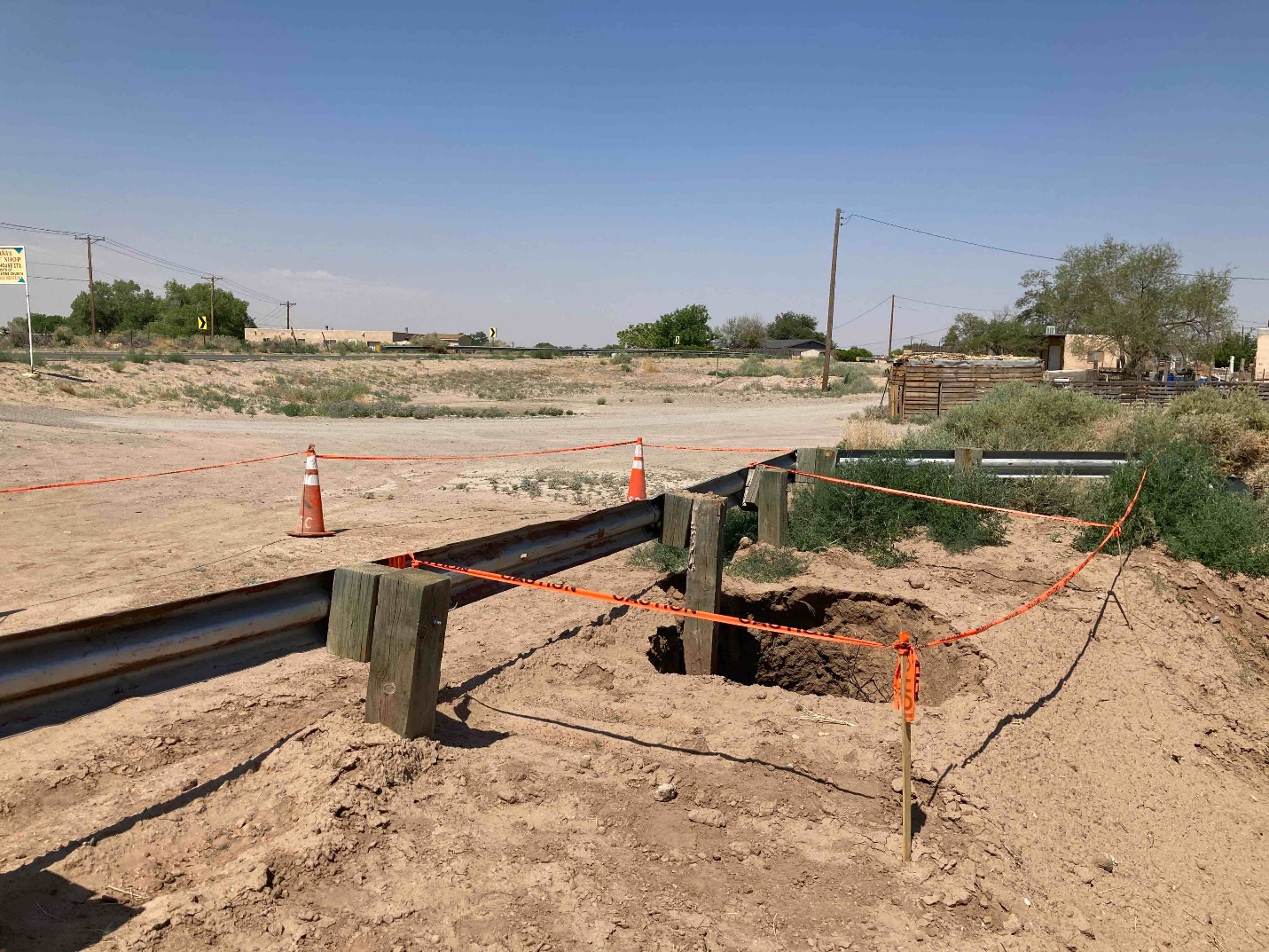
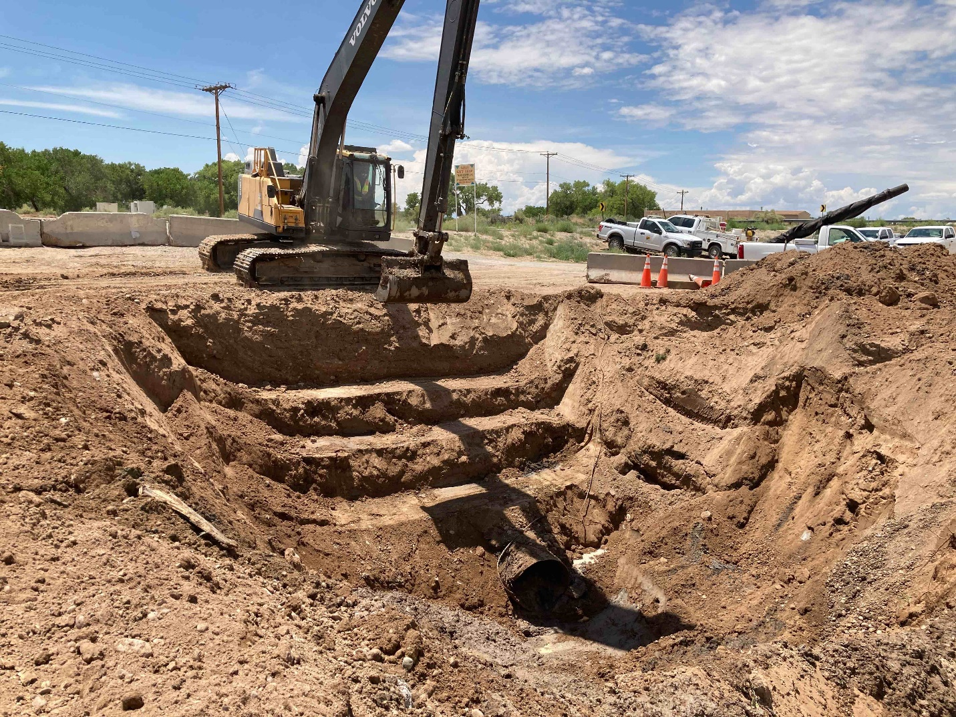
The District has Aging Infrastructure
Isleta Interior Drain at Hwy 147, Sink Hole 2021
Isleta Interior Drain at Hwy 147, Temporary Repairs 2021

Slide 7
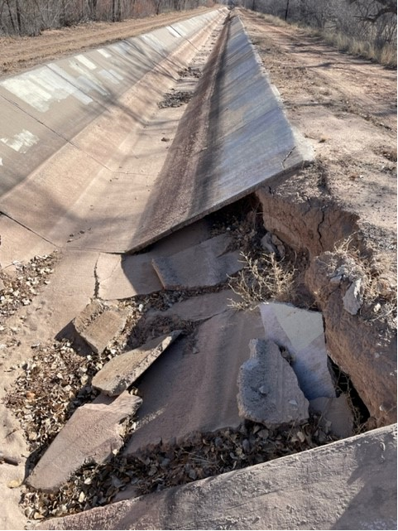
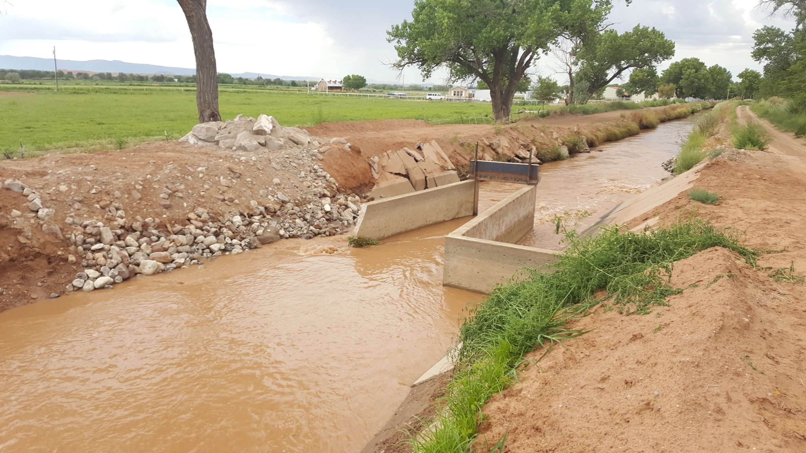
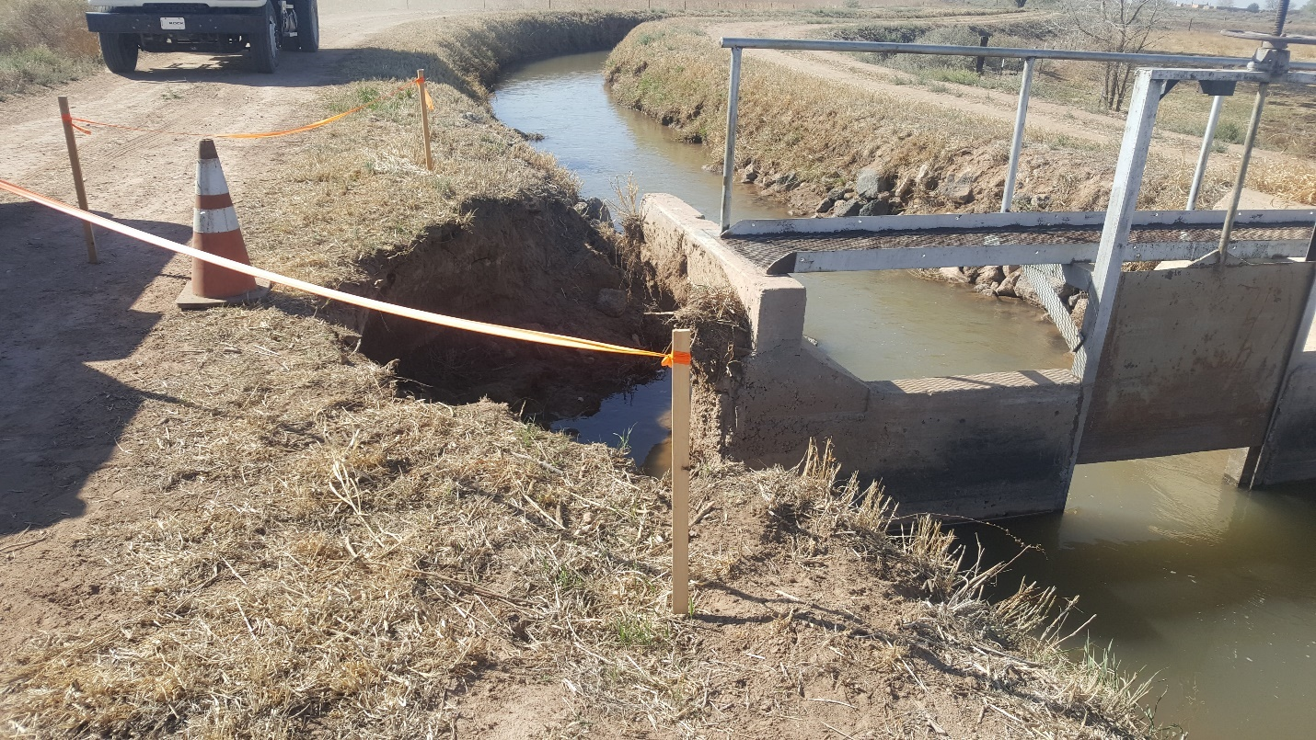
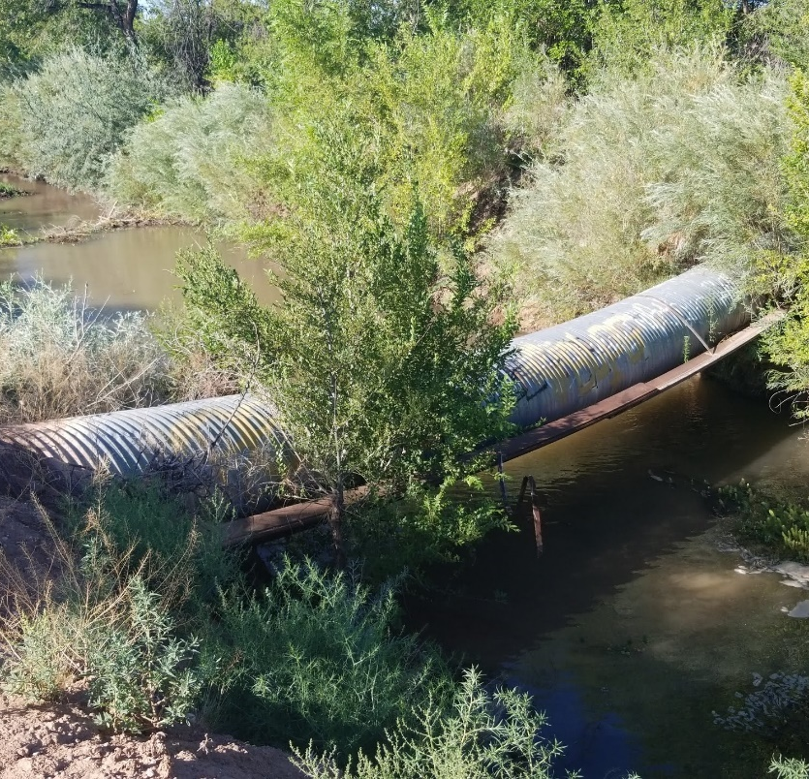
Costly Aging Infrastructure Repairs
El Vado Dam
San Juan Main, Failed Long Crested Weir, 2016
Bosque 3 Lateral, Check Repair 2018
Los Padillas Interior Drain, Waterpass 2020

Slide 8
Deficits
FY2022
FY2023
Budgeted deficit - $(2,089,376)
Budgeted deficit - $(2,189,477)
The District has presented a deficit budget to the Board two years in a row for fiscal years 2022 and 2023. The deficits were mostly due to budgeted expenditures related to failure of infrastructure or purchases of capital equipment.

Slide 9
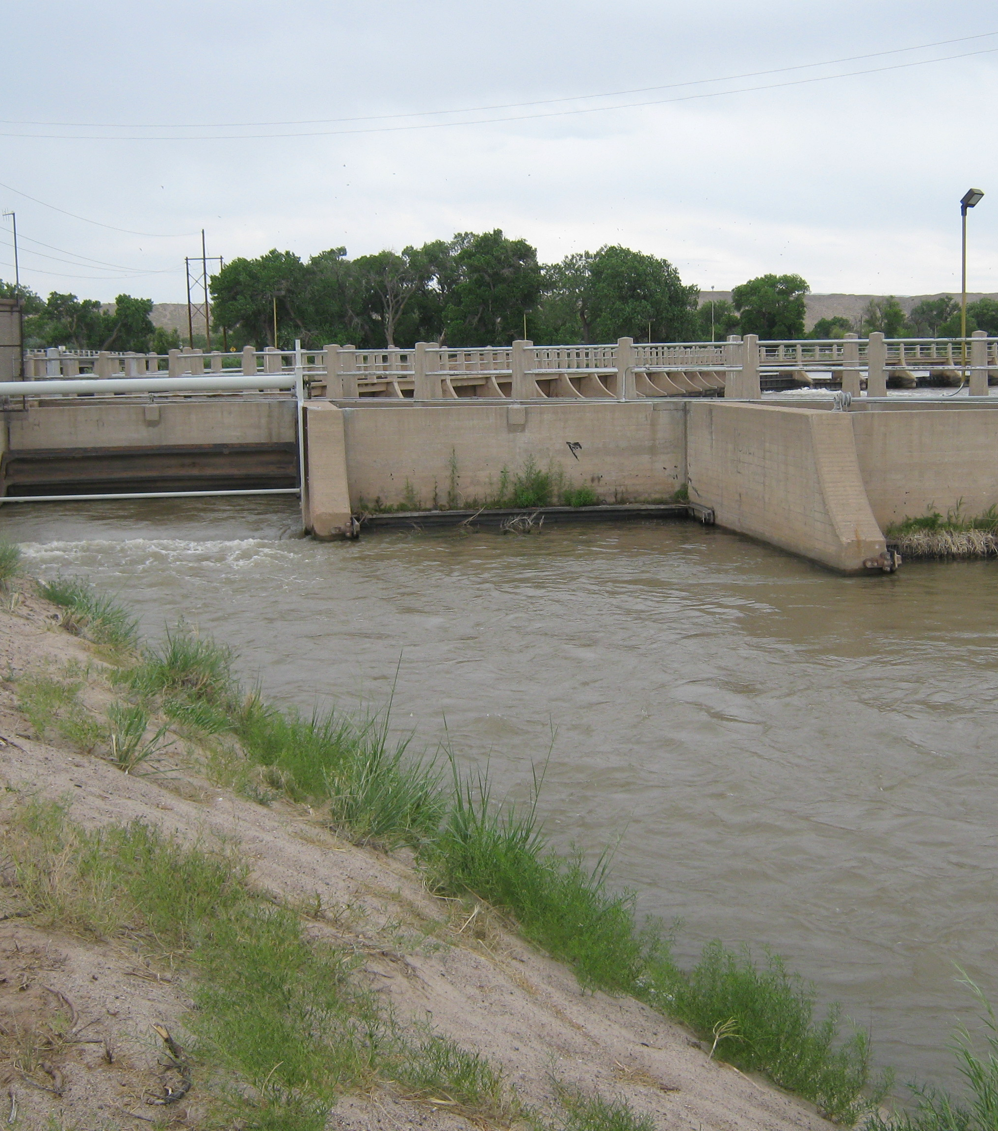
5-Year Forecast
FY2023-FY2027
Beginning in FY2021, the Middle Rio Grande Conservancy District created a 5-Year Forecast that is updated on an annual basis.
The 5-Year Forecast has been updated through FY2027.
In the past, Capital Project Planning was included on a limited basis due to available funds.
Only expenditures related to infrastructure failures and minimal capital asset purchases were included.

Slide 10
5-Year Forecast Starting in FY2024
This year Capital Project Planning was incorporated into the 5-Year Forecast.
10

Slide 11
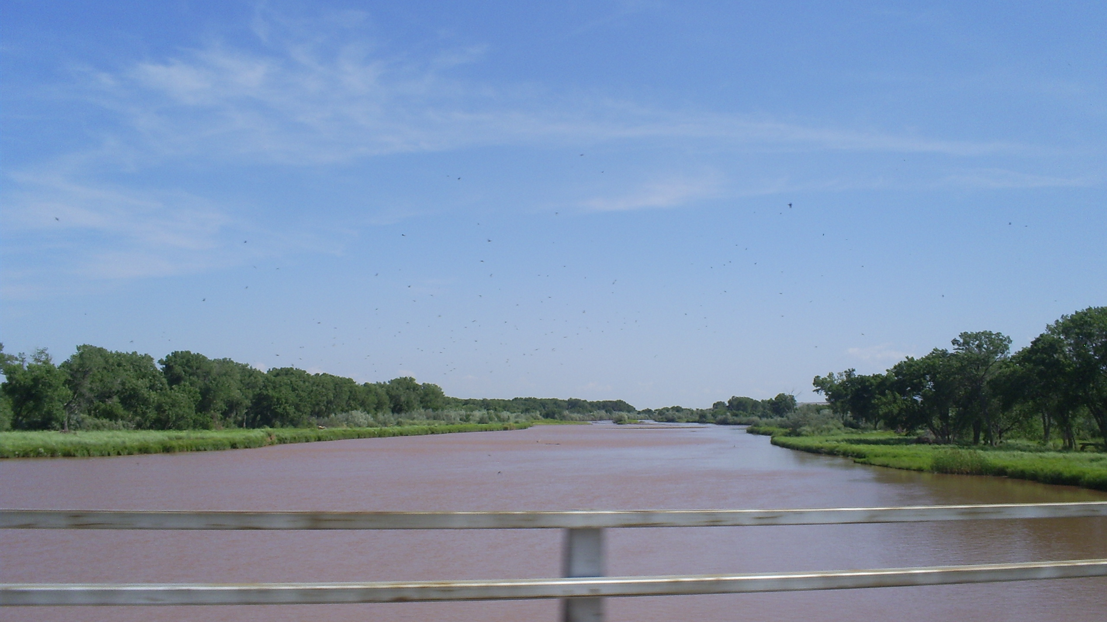
Project Planning
Project Planning
The District has created a list of Capital Investment Projects that are in alignment with our goals of repairing or replacing aging equipment and infrastructure, increasing efficiency of water delivery, while considering the impacts on the environment.
11

Slide 12
Total Cost of Capital Investment Projects
Cost of Capital Investment Projects by County

Slide 13
Cost of Capital Investment Projects
On the Priority List
Priority | Project Name | Year Built | Year(s) Rehabed | Estimated Project Cost
1 | Corrales Siphon | Design Drawings 1933 | Rock Weir:2016, Weir Extension:2020 | 8,500,000
2 | Socorro Main Canal Channel Lining |  |  | 66,500,000
3 | El Vado Stilling Basin | 1933/1934 | Outlet Works: 1970's, Power Project:1985 | 3,500,000
4 | Atrisco Siphon Explorative Condition Assessment | Heading: 1933, Siphon: 1955 |  | 500,000
5 | Feeder 3 Pump Station |  |  | 6,500,000
6 | Belen Highline Realignment Project |  |  | 15,000,000
7 | Belen watershed study project |  |  | 720,000
8 | Peralta Drain Pedestrian Bridge |  |  | 350,000
9 | Loretta Road Intersection |  |  | 1,000,000
10 | Isleta Drain/NM 147 Culvert | 1955 | Extension: 1974 | 1,000,000
11 | LFCC/San Lorenzo Arryo Culvert Crossing |  |  | 5,000,000
12 | ER&T Building |  |  | 10,000,000
13 | Isleta Dam Gate Automation |  |  | 1,000,000
14 | Isleta Bridge Design | 1934 |  | 830,000
15 | Water Measurement Structures-(60 Structures) |  |  | 5,400,000
16 | San Acacia Dam Gate Automation |  |  | 1,500,000
17 | Turnout Upgrade |  |  | 24,000,000
18 | Records Building |  |  | 1,200,000
19 | El Vado Dam Rehabilitation (15% Non-Fed Cost) | 1933/1934 | Outlet Works: 1970's, Power Project:1985 | 22,500,000
 |  | Total Capital Investment Projects - Priority List |  | $ 175,000,000

Slide 14
Cost of Capital Investment Projects
On the List for Future Planning
Future Projects | Project Name | Estimated Project Cost
 | Albuquerque Main Canal Channel Lining | 63,000,000
 | Arenal Main Canal Channel Lining | 28,000,000
 | Bar Main Channel Lining | 18,750,000
 | Corrales Main Channel Lining | 28,600,000
 | Peralta Main Channel Lining | 60,770,000
 | Belen Highline Channel Lining | 97,950,000
 | San Juan Main Canal Channel Lining | 17,100,000
 | Sili Main Canal Channel Lining | 41,000,000
 | Cochiti Main Canal Channel Lining | 39,200,000
 | Atrisco Siphon | 10,500,000
 | San Felipe Siphon | 8,500,000
 | Bernalillo to Belen Levee (25% Non-Fed Cost) | 89,650,000
 | San Acacia Fish Passage | 2,000,000
 | Total Capital Investment Projects – Future Planning | $505,000,000

Slide 15
Capital Investment Projects Built Into the 5-Year Forecast FY23-FY27
*Includes cost of debt service

Slide 16
Operational Projects built into the 5-year forecast
FY23-FY27
 |  |  |  | By Fiscal Year
No. | Project | Total Cost of Project FY23-FY27 |  | FY2023 | FY2024 | FY2025 | FY2026 | FY2027 | Total FY23-FY27
O | Traffic Control Devices | 340,000 |  | 160,000 | 30,000 | 50,000 | 50,000 | 50,000 | 340,000
O | Isleta Settlement | 630,000 |  |  | 200,000 | 430,000 |  |  | 630,000
O | Equipment | 8,200,000 |  | 1,000,000 | 1,200,000 | 2,000,000 | 2,000,000 | 2,000,000 | 8,200,000
O | Automatic Control Gates | 160,000 |  |  | 40,000 | 40,000 | 40,000 | 40,000 | 160,000
O | Other Capital expenditures-Building, Computer | 390,000 |  |  | 95,000 | 95,000 | 100,000 | 100,000 | 390,000
O | NFWF Environmental Projects - Outfalls, Fish Passage | 4,200,000 |  | 800,000 | 900,000 | 900,000 | 800,000 | 800,000 | 4,200,000
O | Socorro Levy Certification | 25,000 |  |  | 25,000 |  |  |  | 25,000
O | Bernalillo Culvert Contribution | 100,000 |  |  | 100,000 |  |  |  | 100,000
O | Rio Grande Levee Safety Scoping Study VLR | 30,000 |  |  | 30,000 |  |  |  | 30,000
O | Corrales Siphon Pumping | 300,000 |  |  | 300,000 |  |  |  | 300,000
O | Infrastructure Assessment | 125,000 |  |  | 75,000 | 50,000 |  |  | 125,000
 | Total Operational Projects | $ 14,500,000 |  | 1,960,000 | 2,995,000 | 3,565,000 | 2,990,000 | 2,990,000 | 14,500,000

Slide 17
Total Projects Built Into the 5-year Forecast
FY23-FY27
*Includes cost of debt service

Slide 18
How do we pay for a Capital Investment Program?
In order to fund the Capital Investment and Operational projects planned;
  The District would need to increase the mill rate by 3 mills beginning in FY2024.

Slide 19
Mill Rate Impact Analysis
It is the District’s goal to limit the financial impact to our constituents but retain the ability to continue to perform the District’s mission.
A plan has been developed to increase grants, secure more loans, and increase the mill rate.
19

Slide 20
Mill Rate Impact Analysis
For each 1 mill increase, ad valorem will increase by $4,300,000 million per year.
20

Slide 21
Mill rate impact analysis
For FY2024-FY2027
If we get $26,000,000 in grants;
We only need a 1.46 mill increase
If we get an additional $7,700,000 in loans, plus the $26,000,000 in grants;
We only need a 1 mill increase
21

Slide 22
What If We Just Apply For Grants and Loans?
Projected Deficits of the 5-Year Capital Investment and Operations Funds
FY2023 Forecasted Deficit $(2,189,477)
Current Fiscal Year
FY2024 Forecasted Deficit $(4,112,668)
FY2025 Forecasted Deficit
$(4,095,996)
FY2026 Forecasted Deficit
$(4,280,592)
FY2027 Forecasted Deficit
$(3,873,081)

Slide 23
Proposal
Aggressively Seek Out Grants to Help Pay for Capital Investment
Apply for Loans to Supplement Capital Investment Costs
Increase the Mill Rate by 1 Mill
  Create a Capital Investment Fund with the 1 mill and Dedicating it Strictly to Capital Investment, Debt Service and District Match on Grants

Slide 24
Impact to Owners
Taxable value of a Property | Net Taxable | Ad Valorem Increase
100,000 | 33,333 | $ 33
200,000 | 66,667 | $ 67
300,000 | 100,000 | $ 100

Slide 25
If MRGCD Gets a 1 Mill Increase in FY24
Project Cost Sources FY24-FY27 Would Be
Funding Source | Total | % of Total
Grants | $ 26,000,000 | 50%
Loan Proceeds | 7,700,000 | 15%
District Match on Grants* | 5,000,000 | 10%
Debt service payments* | 1,200,000 | 2%
Capital Investment Fund* | 9,000,000 | 17%
District Operating Funds | 3,100,000 | 6%
Total | $ 52,000,000 | 100%
The 1 Mill will add up to about $17,000,000 million over the next four years.
The 1 Mill will pay for District Match on Grants $5,000,000, New Debt Service $1,200,000, Projects $9,000,000, and Current Debt $1,600,000

Slide 26
Projected Surplus – with a 1 mill increase
Fund | FY2024 | FY2025 | FY2026 | FY2027
Operating Fund | 86,636 | 145,576 | 95,361 | 254,143
Capital Investment Fund | 2,282 | 23,038 | 41,627 | 355,284
Any surpluses will be held in reserve for future capital investment projects.
Per NM State Statute 73-18-7.1 – The Board of Directors can establish by resolution the annual assessments to be made from year to year against real property. Such assessment may be modified in like manner from time to time, but not more frequently than once every five years.

Slide 27
What If We Just Go After a ¾ Mill Increase?
Projected Surplus/(Deficit) – with a 3/4 mill increase
Fund | FY2024 | FY2025 | FY2026 | FY2027
Operating Fund | 86,636 | 145,576 | 62,361 | 221,143
Capital Investment Fund | (1,008,711) | (1,003,119) | (999,923) | (701,889)

Slide 28
Summary
  The District is not bringing in enough funding to cover operating costs, debt service and capital expenditures.
  The District has been actively seeking grants for capital needs but there is often a match, or a loan component and the District does not have enough funds to cover these requirements.
  A 1 mill increase would bring in approximately $4.3 million annually into the Capital Investment Fund that would pay for Capital Investment Projects, Debt Service, and District Match on Grants.
  The District can only increase mill rates every 5 years (see NMSA 73-18-7.1)
  Any surpluses would be held in reserve for future capital investment projects.

Slide 29
Benefits of the Plan
Takes the Burden of Debt Service and Large Operational Projects off the Operational Fund thereby reducing the need for an Operational Mill Rate Increase in the Future. The District can only increase the mill rates every 5 years.
Dedicating the 1 mill to Strictly Capital Investment, Debt Service and District Match, the Program Acts as a Bonding/Debt Servicing program.
Puts the District in a Strong Financial Position for any Unforeseen Infrastructure Failures.
The District is being proactive and not reactive.

Slide 30
The Staff and the Finance Committee Recommend:
The FY2024 Budget be developed with the premise that an additional 1 mill will be included in the MRGCD Ad Valorem assessment to be used strictly for the Capital Investment Fund for Capital Investment Projects, Debt Service, and District Match on Grants.
The recommendation will be presented to the Board at the April meeting for approval to allow time for the development for the FY2024 budget.

